Slide 2
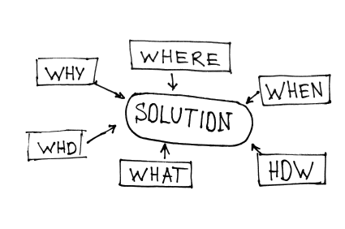
Introduction to Evoque Technologies
Who we are | Resources | Service Offerings | Methodologies

Slide 3
Evoque Technologies – Who we are?
“Evoque is an emerging provider of Enterprise Performance Management (EPM) and Business Intelligence (BI) solutions across various industry sectors”
Solutions for Oracle | Hyperion Products
Business Consulting| Project Management | Offshore Assistance
Enterprise Data Integration | Installation & Configuration
Management Reporting| OBIEE | OBIApps
SSL Configuration| ERPi / ODI / FDM Consulting | Writeback & Drill-Through
Planning & Budgeting| Essbase | Financial Consolidation Applications
Application Re-engineering | Migration | Upgrade
Support | Maintenance | Education & Training
EPM and BI Center of Excellence for Research and Support

Slide 4
Evoque Technologies – Resources
“Evoque offers a complete and diverse line of EPM & BI solutions across various industry sectors built on Oracle Hyperion platforms that helps companies improve business performance today, while preparing them for the challenges of tomorrow”
Oracle EPM | BI knowledge pool including:
Professional Services Consultants | Technical Leads
Solution Architects | Design Specialists
Project Managers
Certified Trainers | Support Consultants
Technology focused teams for EPM, BI and Reporting
Unique, client-focused culture and long term relationships
Offshore development capabilities for Cost Optimization
24x7 development and Global Support Model

Slide 5
Evoque Technologies - Service Offerings
“Evoque Technologies is your one-stop shop for all your EPM / BI services and support.”
EPM / BI Consulting
Information Portfolio Analysis
Technology Assessment
EPM / BI Strategy Formulation
Solution Architecture and Framework Definition
EPM / BI Solutions Delivery
Data Quality Improvement
Enterprise Information Integration
Essbase & Planning Solutions
Enterprise Information Delivery
Analytic Applications
Data Integration
Administration and Support
Operations Support
Administration
EPM / BI Applications Administration
Product/ Application Maintenance
Reengineering, Migration and Upgrade
Product Upgrade
Product Migration
EPM / BI Solution Reengineering
EPM / BI Performance Tuning & Health-check

Slide 6
Evoque - Service Offerings
“Whether you wish to enhance the application or product specific training, we are at the cutting edge to provide you with all the expertise you will ever need”
Oracle Hyperion EPM / BI and Oracle BI Services:
Installation / Configuration; 32 Bit and 64 Bit
Installation; Win, Linux, Unix, AIX Solaris Platforms
System 9 to the Latest Version 11.1.2.2
SSL Configuration
Drill Through and Write Back Configurations
Education & Trainings
Demos & POC
Implementation
Enhancements
Migrations & AMC
Oracle Hyperion EPM / BI Products:
Hyperion Essbase
Hyperion Planning
Financial Reporting / Web Analysis
Financial Data Management (FDM)
Oracle Data Integrator (ODI)
ERPi
OBIEE
BI Publisher
Dashboards
OBIApps (FA, SCM, P&S, HRMS)

Slide 7
Evoque Technologies - Methodologies
“Evoque’s Integrated Development Methodology”
Product Training
System Setup & Requirements
System Design
Application Build & Integration
SIT, User Training & UAT
Admin Training & Go Live

Slide 8
Next Steps
Identify immediate pain areas and requirements
Prioritize
Agree on Engagement/ Execution Model
Pilot / Engage

